Slide 1
Chapter 21: The Linux System

Slide 2
Chapter 21: The Linux System
Design Principles
Kernel Modules
Process Management
Scheduling
Memory Management
File Systems
Interprocess Communication
Security

Slide 3
Objectives
To explore the history of the UNIX operating system from which Linux is derived and the principles which Linux is designed upon
To examine the Linux process model and illustrate how Linux schedules processes and provides interprocess communication
To look at memory management in Linux
To explore how Linux implements file systems and manages I/O devices

Slide 4
History
Linux is a modern, free operating system based on UNIX standards
First developed as a small but self-contained kernel in 1991 by Linus Torvalds, with the major design goal of UNIX compatibility
Its history has been one of collaboration by many users from all around the world, corresponding almost exclusively over the Internet
It has been designed to run efficiently and reliably on common PC hardware, but also runs on a variety of other platforms
The core Linux operating system kernel is entirely original, but it can run much existing free UNIX software, resulting in an entire UNIX-compatible operating system free from proprietary code
Many, varying Linux Distributions including the kernel, applications, and management tools

Slide 5
The Linux Kernel
Version 0.01 (May 1991) had no networking, ran only on 80386-compatible Intel processors and on PC hardware, had extremely limited device-drive support, and supported only the Minix file system
Linux 1.0 (March 1994) included these new features:
Support for UNIX’s standard TCP/IP networking protocols
BSD-compatible socket interface for networking programming
Device-driver support for running IP over an Ethernet
Enhanced file system
Support for a range of SCSI controllers for high-performance disk access
Extra hardware support
Version 1.2 (March 1995) was the final PC-only Linux kernel

Slide 6
Linux 2.0
Released in June 1996, 2.0 added two major new capabilities:
Support for multiple architectures, including a fully 64-bit native Alpha port
Support for multiprocessor architectures
Other new features included:
Improved memory-management code
Improved TCP/IP performance
Support for internal kernel threads, for handling dependencies between loadable modules, and for automatic loading of modules on demand
Standardized configuration interface
Available for Motorola 68000-series processors, Sun Sparc systems, and for PC and PowerMac systems
2.4 and 2.6 increased SMP support, added journaling file system, preemptive kernel, 64-bit memory support

Slide 7
The Linux System
Linux uses many tools developed as part of Berkeley’s BSD operating system, MIT’s X Window System, and the Free Software Foundation's GNU project
The min system libraries were started by the GNU project, with improvements provided by the Linux community
Linux networking-administration tools were derived from 4.3BSD code; recent BSD derivatives such as Free BSD have borrowed code from Linux in return
The Linux system is maintained by a loose network of developers collaborating over the Internet, with a small number of public ftp sites acting as de facto standard repositories

Slide 8
Linux Distributions
Standard, precompiled sets of packages, or distributions, include the basic Linux system, system installation and management utilities, and ready-to-install packages of common UNIX tools
The first distributions managed these packages by simply providing a means of unpacking all the files into the appropriate places; modern distributions include advanced package management
Early distributions included SLS and Slackware
Red Hat and Debian are popular distributions from commercial and noncommercial sources, respectively
The RPM Package file format permits compatibility among the various Linux distributions

Slide 9
Linux Licensing
The Linux kernel is distributed under the GNU General Public License (GPL), the terms of which are set out by the Free Software Foundation
Anyone using Linux, or creating their own derivative of Linux, may not make the derived product proprietary; software released under the GPL may not be redistributed as a binary-only product

Slide 10
Design Principles
Linux is a multiuser, multitasking system with a full set of UNIX-compatible tools
Its file system adheres to traditional UNIX semantics, and it fully implements the standard UNIX networking model
Main design goals are speed, efficiency, and standardization
Linux is designed to be compliant with the relevant POSIX documents; at least two Linux distributions have achieved official POSIX certification
The Linux programming interface adheres to the SVR4 UNIX semantics, rather than to BSD behavior

Slide 11
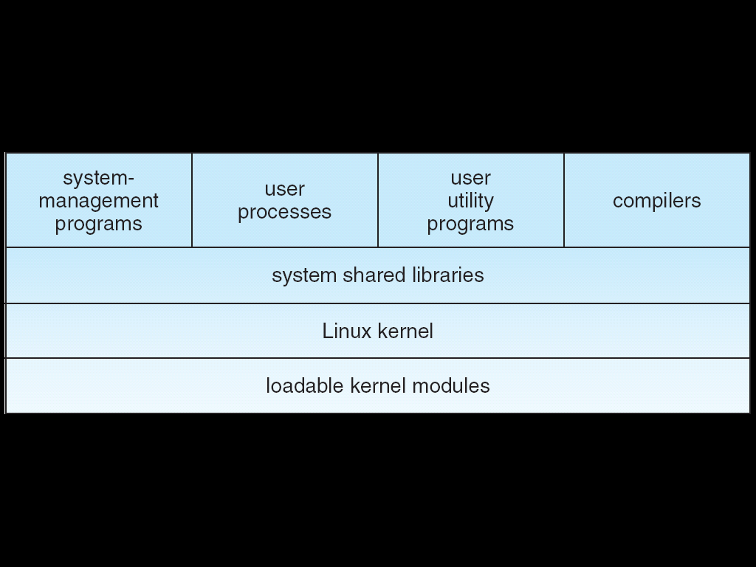
Components of a Linux System

Slide 12
Components of a Linux System (Cont.)
Like most UNIX implementations, Linux is composed of three main bodies of code; the most important distinction between the kernel and all other components.
The kernel is responsible for maintaining the important abstractions of the operating system
Kernel code executes in kernel mode with full access to all the physical resources of the computer
All kernel code and data structures are kept in the same single address space
The system libraries define a standard set of functions through which applications interact with the kernel, and which implement much of the operating-system functionality that does not need the full privileges of kernel code.
The system utilities perform individual specialized management tasks.

Slide 13
Kernel Modules
Sections of kernel code that can be compiled, loaded, and unloaded independent of the rest of the kernel.
A kernel module may typically implement a device driver, a file system, or a networking protocol.
The module interface allows third parties to write and distribute, on their own terms, device drivers or file systems that could not be distributed under the GPL.
Kernel modules allow a Linux system to be set up with a standard, minimal kernel, without any extra device drivers built in.
Three components to Linux module support:
module management
driver registration
conflict resolution

Slide 14
Module Management
Supports loading modules into memory and letting them talk to the rest of the kernel
Module loading is split into two separate sections:
Managing sections of module code in kernel memory
Handling symbols that modules are allowed to reference
The module requestor manages loading requested, but currently unloaded, modules; it also regularly queries the kernel to see whether a dynamically loaded module is still in use, and will unload it when it is no longer actively needed

Slide 15
Driver Registration
Allows modules to tell the rest of the kernel that a new driver has become available
The kernel maintains dynamic tables of all known drivers, and provides a set of routines to allow drivers to be added to or removed from these tables at any time
Registration tables include the following items:
Device drivers
File systems
Network protocols
Binary format

Slide 16
Conflict Resolution
A mechanism that allows different device drivers to reserve hardware resources and to protect those resources from accidental use by another driver.
The conflict resolution module aims to:
Prevent modules from clashing over access to hardware resources
Prevent autoprobes ( device driver probes that auto detect device configuration) from interfering with existing device drivers
Resolve conflicts with multiple drivers trying to access the same hardware

Slide 17
Process Management
UNIX process management separates the creation of processes and the running of a new program into two distinct operations.
The fork system call creates a new process
A new program is run after a call to execve
Under UNIX, a process encompasses all the information that the operating system must maintain to track the context of a single execution of a single program
Under Linux, process properties fall into three groups: the process’s identity, environment, and context

Slide 18
Process Identity
Process ID (PID). The unique identifier for the process; used to specify processes to the operating system when an application makes a system call to signal, modify, or wait for another process.
Credentials. Each process must have an associated user ID and one or more group IDs that determine the process’s rights to access system resources and files.
Personality. Not traditionally found on UNIX systems, but under Linux each process has an associated personality identifier that can slightly modify the semantics of certain system calls.
Used primarily by emulation libraries to request that system calls be compatible with certain specific flavors of UNIX

Slide 19
Process Environment
The process’s environment is inherited from its parent, and is composed of two null-terminated vectors:
The argument vector lists the command-line arguments used to invoke the running program; conventionally starts with the name of the program itself.
The environment vector is a list of “NAME=VALUE” pairs that associates named environment variables with arbitrary textual values.
Passing environment variables among processes and inheriting variables by a process’s children are flexible means of passing information to components of the user-mode system software.
The environment-variable mechanism provides a customization of the operating system that can be set on a per-process basis, rather than being configured for the system as a whole.

Slide 20
Process Context
The (constantly changing) state of a running program at any point in time.
The scheduling context is the most important part of the process context; it is the information that the scheduler needs to suspend and restart the process.
The kernel maintains accounting information about the resources currently being consumed by each process, and the total resources consumed by the process in its lifetime so far.
The file table is an array of pointers to kernel file structures.
When making file I/O system calls, processes refer to files by their index into this table.
Whereas the file table lists the existing open files, the file-system context applies to requests to open new files.
The current root and default directories to be used for new file searches are stored here.
The signal-handler table defines the routine in the process’s address space to be called when specific signals arrive.
The virtual-memory context of a process describes the full contents of the its private address space.

Slide 21
Processes and Threads
Linux uses the same internal representation for processes and threads; a thread is simply a new process that happens to share the same address space as its parent.
A distinction is only made when a new thread is created by the clone system call.
fork creates a new process with its own entirely new process context
clone creates a new process with its own identity, but that is allowed to share the data structures of its parent
Using clone gives an application fine-grained control over exactly what is shared between two threads.

Slide 22
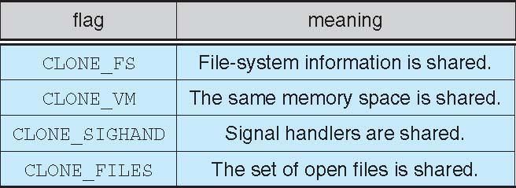
Linux Threads

Slide 23
Scheduling
The job of allocating CPU time to different tasks within an operating system.
While scheduling is normally thought of as the running and interrupting of processes, in Linux, scheduling also includes the running of the various kernel tasks.
Running kernel tasks encompasses both tasks that are requested by a running process and tasks that execute internally on behalf of a device driver.
As of 2.5, new scheduling algorithm – preemptive, priority-based
Real-time range
nice value

Slide 24
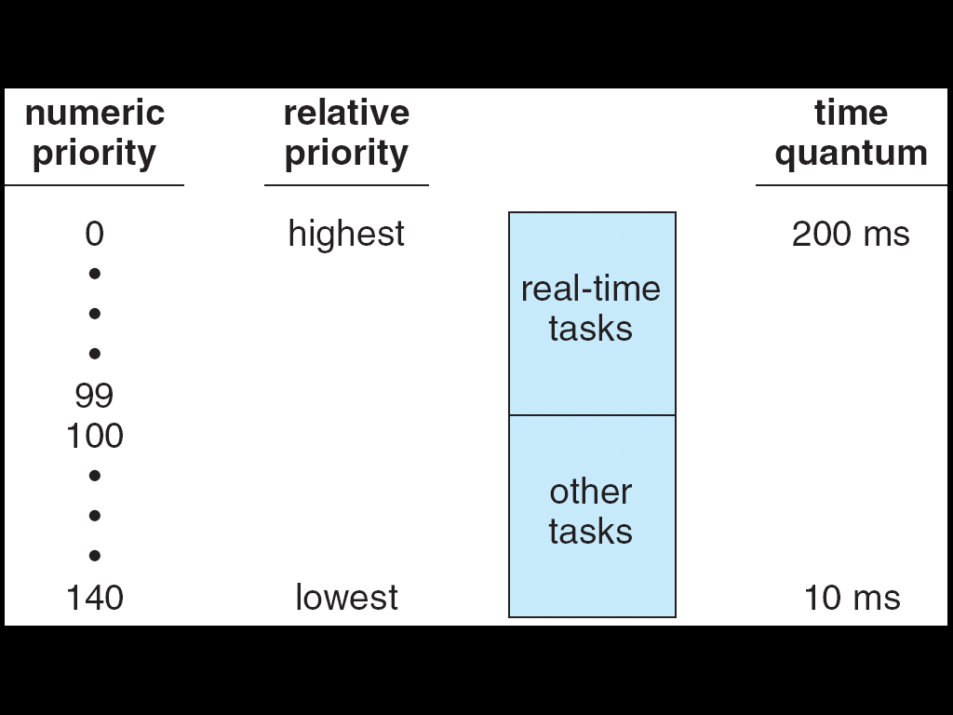
Relationship Between Priorities and Time-slice Length

Slide 25
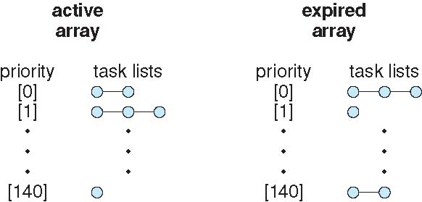
List of Tasks Indexed by Priority

Slide 26
Kernel Synchronization
A request for kernel-mode execution can occur in two ways:
A running program may request an operating system service, either explicitly via a system call, or implicitly, for example, when a page fault occurs
A device driver may deliver a hardware interrupt that causes the CPU to start executing a kernel-defined handler for that interrupt
Kernel synchronization requires a framework that will allow the kernel’s critical sections to run without interruption by another critical section.

Slide 27
Kernel Synchronization (Cont.)
Linux uses two techniques to protect critical sections:
1. Normal kernel code is nonpreemptible (until 2.4) – when a time interrupt is received while a process is executing a kernel system service routine, the kernel’s need_resched flag is set so that the scheduler will run once the system call has completed and control is about to be returned to user mode
2. The second technique applies to critical sections that occur in an interrupt service routines
– By using the processor’s interrupt control hardware to disable interrupts during a critical section, the kernel guarantees that it can proceed without the risk of concurrent access of shared data structures

Slide 28
Kernel Synchronization (Cont.)
To avoid performance penalties, Linux’s kernel uses a synchronization architecture that allows long critical sections to run without having interrupts disabled for the critical section’s entire duration
Interrupt service routines are separated into a top half and a bottom half.
The top half is a normal interrupt service routine, and runs with recursive interrupts disabled
The bottom half is run, with all interrupts enabled, by a miniature scheduler that ensures that bottom halves never interrupt themselves
This architecture is completed by a mechanism for disabling selected bottom halves while executing normal, foreground kernel code

Slide 29
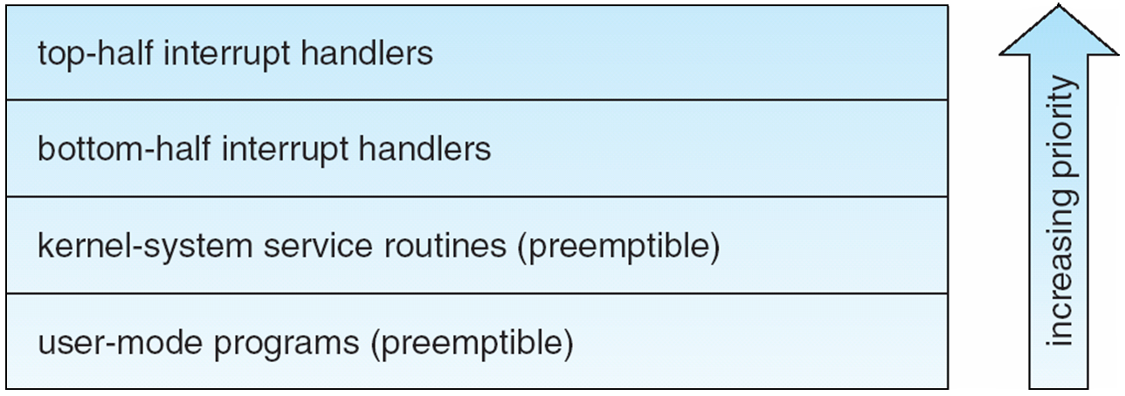
Interrupt Protection Levels
Each level may be interrupted by code running at a higher level, but will never be interrupted by code running at the same or a lower level.
User processes can always be preempted by another process when a time-sharing scheduling interrupt occurs.

Slide 30
Process Scheduling
Linux uses two process-scheduling algorithms:
A time-sharing algorithm for fair preemptive scheduling between multiple processes.
A real-time algorithm for tasks where absolute priorities are more important than fairness.
A process’s scheduling class defines which algorithm to apply.
For time-sharing processes, Linux uses a prioritized, credit based algorithm
The crediting rule factors in both the process’s history and its priority.
This crediting system automatically prioritizes interactive or I/O-bound processes.

Slide 31
Process Scheduling (Cont.)
Linux implements the FIFO and round-robin real-time scheduling classes; in both cases, each process has a priority in addition to its scheduling class.
The scheduler runs the process with the highest priority; for equal-priority processes, it runs the process waiting the longest.
FIFO processes continue to run until they either exit or block .
A round-robin process will be preempted after a while and moved to the end of the scheduling queue, so that round-robin processes of equal priority automatically time-share between themselves.

Slide 32
Symmetric Multiprocessing
Linux 2.0 was the first Linux kernel to support SMP hardware; separate processes or threads can execute in parallel on separate processors.
To preserve the kernel’s nonpreemptible synchronization requirements, SMP imposes the restriction, via a single kernel spinlock, that only one processor at a time may execute kernel-mode code.

Slide 33
Memory Management
Linux’s physical memory-management system deals with allocating and freeing pages, groups of pages, and small blocks of memory.
It has additional mechanisms for handling virtual memory, memory mapped into the address space of running processes.
Splits memory into 3 different zones due to hardware characteristics.

Slide 34
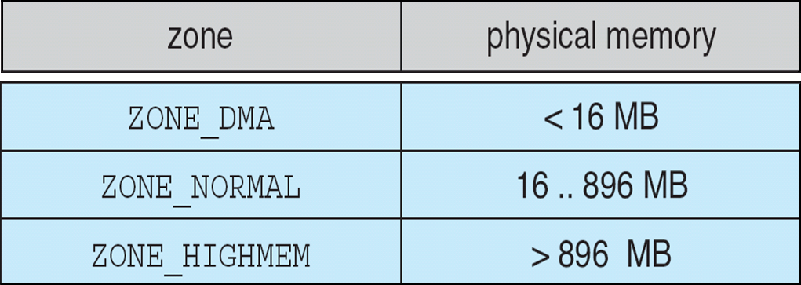
Relationship of Zones and Physical Addresses on 80x86

Slide 35
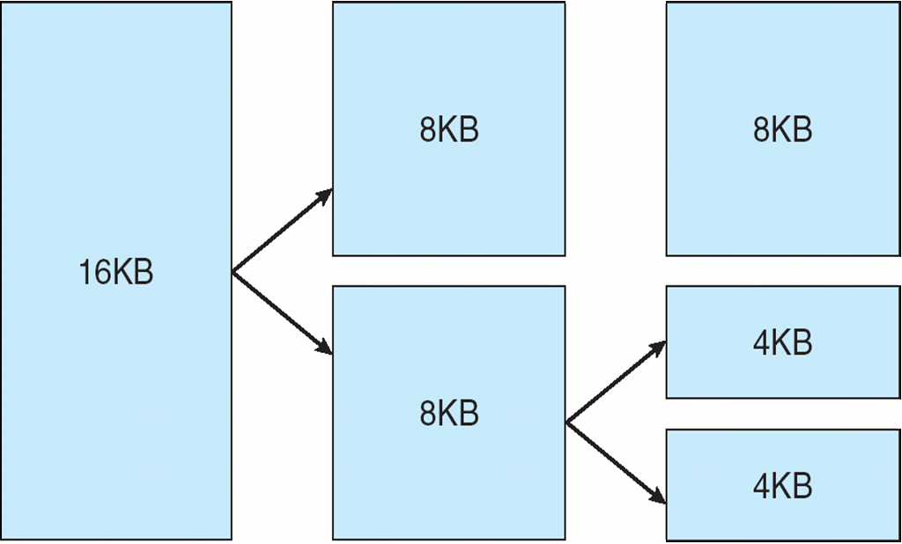
Splitting of Memory in a Buddy Heap

Slide 36
Managing Physical Memory
The page allocator allocates and frees all physical pages; it can allocate ranges of physically-contiguous pages on request.
The allocator uses a buddy-heap algorithm to keep track of available physical pages
Each allocatable memory region is paired with an adjacent partner
Whenever two allocated partner regions are both freed up they are combined to form a larger region
If a small memory request cannot be satisfied by allocating an existing small free region, then a larger free region will be subdivided into two partners to satisfy the request.
Memory allocations in the Linux kernel occur either statically (drivers reserve a contiguous area of memory during system boot time) or dynamically (via the page allocator).
Also uses slab allocator for kernel memory.

Slide 37
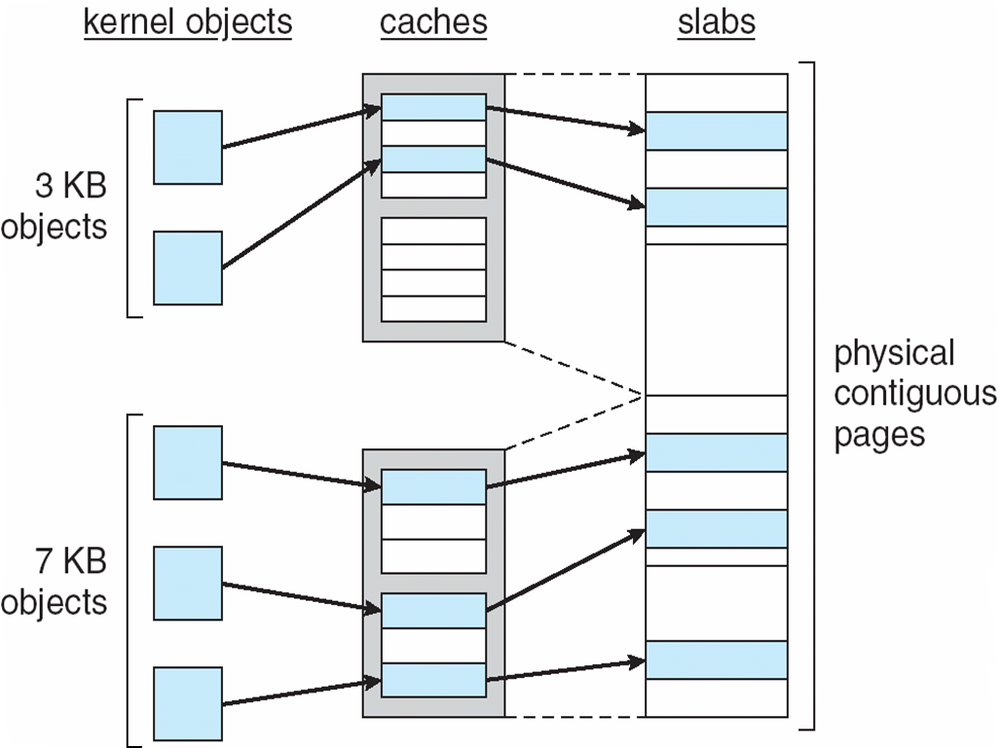
21.07

Slide 38
Virtual Memory
The VM system maintains the address space visible to each process: It creates pages of virtual memory on demand, and manages the loading of those pages from disk or their swapping back out to disk as required.
The VM manager maintains two separate views of a process’s address space:
A logical view describing instructions concerning the layout of the address space
The address space consists of a set of nonoverlapping regions, each representing a continuous, page-aligned subset of the address space
A physical view of each address space which is stored in the hardware page tables for the process

Slide 39
Virtual Memory (Cont.)
Virtual memory regions are characterized by:
The backing store, which describes from where the pages for a region come; regions are usually backed by a file or by nothing (demand-zero memory)
The region’s reaction to writes (page sharing or copy-on-write)
The kernel creates a new virtual address space
1. When a process runs a new program with the exec system call
2. Upon creation of a new process by the fork system call

Slide 40
Virtual Memory (Cont.)
On executing a new program, the process is given a new, completely empty virtual-address space; the program-loading routines populate the address space with virtual-memory regions.
Creating a new process with fork involves creating a complete copy of the existing process’s virtual address space.
The kernel copies the parent process’s VMA descriptors, then creates a new set of page tables for the child.
The parent’s page tables are copied directly into the child’s, with the reference count of each page covered being incremented.
After the fork, the parent and child share the same physical pages of memory in their address spaces.

Slide 41
Swapping and Paging
The VM paging system relocates pages of memory from physical memory out to disk when the memory is needed for something else. Earlier systems performed this relocation by swapping out the contents of the entire processes at once but now major modern versions rely more on paging, i.e. movement of individual pages of virtual memory between physical memory and disk. Linux does not implement whole process swapping it uses the newer paging mechanism.
The VM paging system can be divided into two sections:
The pageout-policy algorithm decides which pages to write out to disk, and when to write them.
The paging mechanism actually carries out the transfer, and pages data back into physical memory as needed again.
Linux’s page out policy uses modified version of second chance algorithm. Here a multiple pass clock is used and every page has an age that is adjusted on each pass of the clock. The age is more precisely a measure of the page’s activity that has been seen recently. Frequently accessed pages will attain a higher age value, but the age of infrequently accessed pages will drop toward zero with each pass. This age allows the pager to select pages to page out based on LFU.
Paging mechanism supports paging both to dedicated swap devices and partitions and to normal files, although swapping to a file is significantly slower due to the extra overhead incurred by the file system.
Blocks are allocated from the swap devices according to a bitmap of used blocks which is maintained in the physical memory at all times.
Allocator uses a next fit algorithm to try to write out pages to continuous runs of disk blocks for improved performance.

Slide 42
Virtual Memory (Cont)
The Linux kernel reserves a constant, architecture-dependent region of the virtual address space of every process for its own internal use .
This kernel virtual-memory area contains two regions:
A static area that contains page table references to every available physical page of memory in the system, so that there is a simple translation from physical to virtual addresses when running kernel code.
The reminder of the reserved section is not reserved for any specific purpose; its page-table entries can be modified to point to any other areas of memory.

Slide 43
Executing and Loading User Programs
Linux maintains a table of functions for loading programs; it gives each function the opportunity to try loading the given file when an exec system call is made.
The registration of multiple loader routines allows Linux to support both the ELF and a.out binary formats.
Initially, binary-file pages are mapped into virtual memory
Only when a program tries to access a given page will a page fault result in that page being loaded into physical memory.
An ELF-format binary file consists of a header followed by several page-aligned sections
The ELF loader works by reading the header and mapping the sections of the file into separate regions of virtual memory.

Slide 44
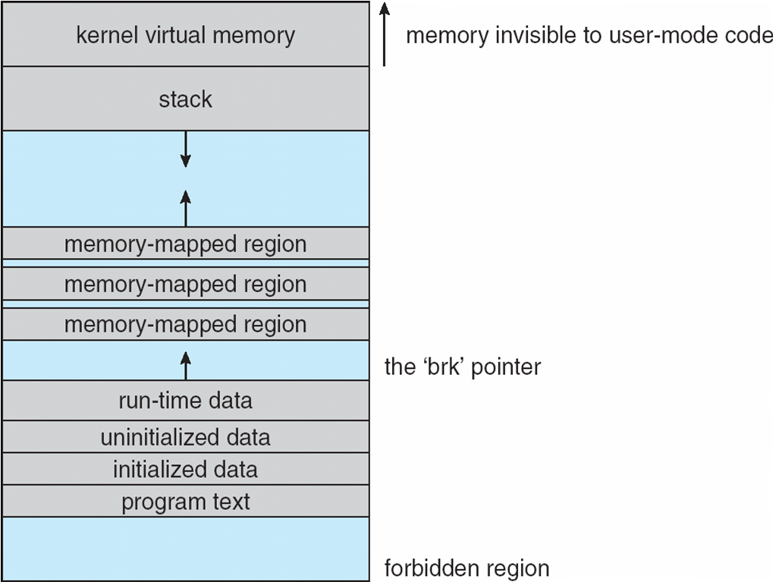
Memory Layout for ELF Programs

Slide 45
Static and Dynamic Linking
A program whose necessary library functions are embedded directly in the program’s executable binary file is statically linked to its libraries.
The main disadvantage of static linkage is that every program generated must contain copies of exactly the same common system library functions.
Dynamic linking is more efficient in terms of both physical memory and disk-space usage because it loads the system libraries into memory only once.

Slide 46
File Systems
To the user, Linux’s file system appears as a hierarchical directory tree obeying UNIX semantics.
Internally, the kernel hides implementation details and manages the multiple different file systems via an abstraction layer, that is, the virtual file system (VFS).
The Linux VFS is designed around object-oriented principles and is composed of two components:
A set of definitions that define what a file object is allowed to look like
A layer of software to manipulate those objects.
The VFD defines four main object tyeps
An inode-object represents an individual file (contains pointers to disk blocks having the actual file)
A file-object structures represent open file (tracks of the file the process is currently reading or writing)
A super block object represent an entire file system
A dentry object represents an individual directory entry
For each of these four object types, the VFS defines a set of operations. Every object of one of these types contains a pointer to a function table. The function table lists the addresses of the actual functions that implement the defined operations for that object. Eg. API for some of operations includes:
Int open……
Int mmap…..

Slide 47
Journaling
Journaling is a feature in the file system whereby modifications to the file system are sequentially written to a journal.
A set of operations that performs a specific task is a transaction.
Once a transaction is written to the journal it is considered to be committed and the system call modifying the file system can return to the user process, allowing it to continue execution.
Meanwhile, the journal entries relating to the transaction are replayed across the actual file system structures.
As the changes are made a pointer is updated to indicate which actions have completed and which are still incomplete.
When an entire committed transaction is completed, it is removed from the journal.
The journal which is actually a circular buffer may be in a separate section of the file system, or it may even be on a separate disk spindle,
If the system crashes there will be 0 or more transactions in the journal.
Those transactions were never completed to the file system event though they were committed by the OS, so they must be completed.
So consistency is maintained.
In case the transaction has been aborted, i.e. it was not committed before the system crashed. Must be undone, again preserving the consistency of the file system.

Slide 48
The Linux Ext2fs File System
Ext2fs uses a mechanism similar to that of BSD Fast File System (ffs) for locating data blocks belonging to a specific file
The main differences between ext2fs and ffs concern their disk allocation policies
In ffs, the disk is allocated to files in blocks of 8Kb, with blocks being subdivided into fragments of 1Kb to store small files or partially filled blocks at the end of a file
Ext2fs does not use fragments; it performs its allocations in smaller units
The default block size on ext2fs is 1Kb, although 2Kb and 4Kb blocks are also supported
Ext2fs uses allocation policies designed to place logically adjacent blocks of a file into physically adjacent blocks on disk, so that it can submit an I/O request for several disk blocks as a single operation

Slide 49
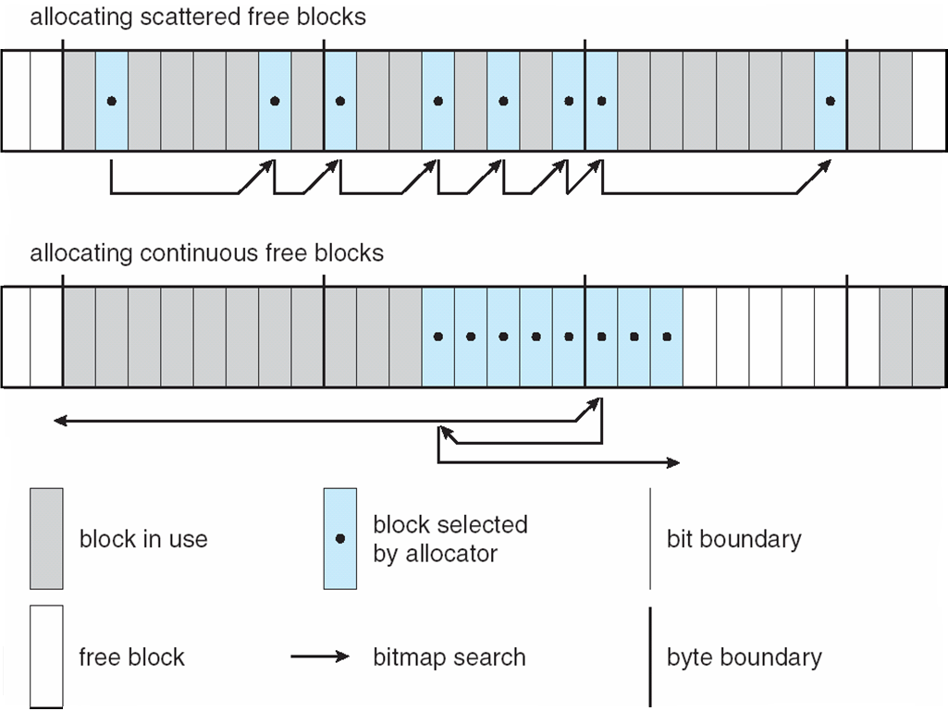
Ext2fs Block-Allocation Policies

Slide 50
The Linux Proc File System
The proc file system does not store data, rather, its contents are computed on demand according to user file I/O requests.
proc must implement a directory structure, and the file contents within; it must then define a unique and persistent inode number for each directory and files it contains
It uses this inode number to identify just what operation is required when a user tries to read from a particular file inode or perform a lookup in a particular directory inode.
When data is read from one of these files, proc collects the appropriate information, formats it into text form and places it into the requesting process’s read buffer.

Slide 51
Input and Output
The Linux device-oriented file system accesses disk storage through two caches:
Data is cached in the page cache, which is unified with the virtual memory system
Metadata is cached in the buffer cache, a separate cache indexed by the physical disk block
Linux splits all devices into three classes:
block devices allow random access to completely independent, fixed size blocks of data
character devices include most other devices; they don’t need to support the functionality of regular files
network devices are interfaced via the kernel’s networking subsystem

Slide 52
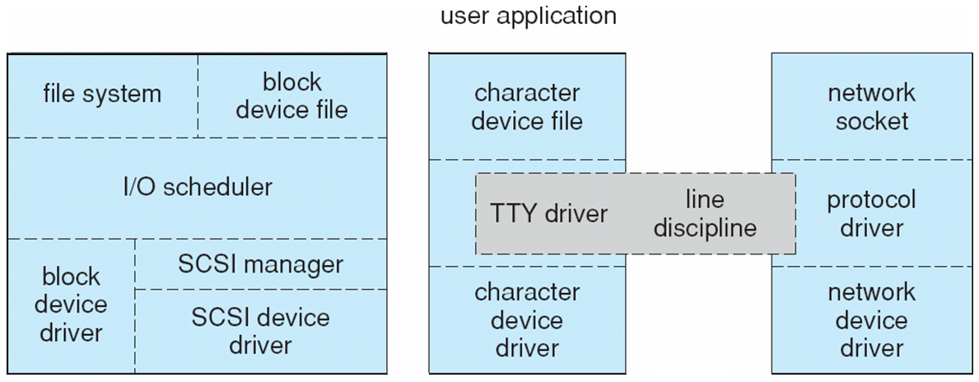
Device-Driver Block Structure

Slide 53
Block Devices
Provide the main interface to all disk devices in a system
The block buffer cache serves two main purposes:
it acts as a pool of buffers for active I/O
it serves as a cache for completed I/O
The request manager manages the reading and writing of buffer contents to and from a block device driver

Slide 54
Character Devices
A device driver which does not offer random access to fixed blocks of data.
A character device driver must register a set of functions which implement the driver’s various file I/O operations.
The kernel performs almost no preprocessing of a file read or write request to a character device, but simply passes on the request to the device.
The main exception to this rule is the special subset of character device drivers which implement terminal devices, for which the kernel maintains a standard interface.

Slide 55
Interprocess Communication
Like UNIX, Linux informs processes that an event has occurred via signals
There is a limited number of signals, and they cannot carry information: Only the fact that a signal occurred is available to a process.
The Linux kernel does not use signals to communicate with processes with are running in kernel mode, rather, communication within the kernel is accomplished via scheduling states and wait.queue structures.

Slide 56
Passing Data Between Processes
The pipe mechanism allows a child process to inherit a communication channel to its parent, data written to one end of the pipe can be read a the other.
Shared memory offers an extremely fast way of communicating; any data written by one process to a shared memory region can be read immediately by any other process that has mapped that region into its address space.
To obtain synchronization, however, shared memory must be used in conjunction with another Interprocess-communication mechanism.

Slide 57
Shared Memory Object
The shared-memory object acts as a backing store for shared-memory regions in the same way as a file can act as backing store for a memory-mapped memory region.
Shared-memory mappings direct page faults to map in pages from a persistent shared-memory object.
Shared-memory objects remember their contents even if no processes are currently mapping them into virtual memory.

Slide 58
Network Structure
Networking is a key area of functionality for Linux.
It supports the standard Internet protocols for UNIX to UNIX communications
It also implements protocols native to nonUNIX operating systems, in particular, protocols used on PC networks, such as Appletalk and IPX
Internally, networking in the Linux kernel is implemented by three layers of software:
The socket interface
Protocol drivers
Network device drivers

Slide 59
Network Structure (Cont.)
The most important set of protocols in the Linux networking system is the internet protocol suite
It implements routing between different hosts anywhere on the network
On top of the routing protocol are built the UDP, TCP and ICMP protocols

Slide 60
Security
Linux security is closely related to typical UNIX security mechanism, classified into two groups:
Authentication: Making sure that nobody can access the system without first proving that she/he has entry rights.
Access control: providing a mechanism for checking whether a user has the right to access a certain object and preventing access to objects as required.

Slide 61
Security
The pluggable authentication modules (PAM) system is available under Linux.
PAM is based on a shared library that can be used by any system component that needs to authenticate users.
Access control under UNIX systems, including Linux, is performed through the use of unique numeric identifiers (uid and gid).
Access control is performed by assigning objects a protections mask, which specifies which access modes—read, write, or execute—are to be granted to processes with owner, group, or world access.

Slide 62
Security (Cont.)
Linux augments the standard UNIX setuid mechanism in two ways:
It implements the POSIX specification’s saved user-id mechanism, which allows a process to repeatedly drop and reacquire its effective uid.
It has added a process characteristic that grants just a subset of the rights of the effective uid.
Linux provides another mechanism that allows a client to selectively pass access to a single file to some server process without granting it any other privileges.

Slide 63
End of Chapter 21

